Slide 1

ProtoControl
Kelly Mae Allen, Abisha Fenn, Nida Kosedagi, Parker Sexton, William Wood

Slide 2
Agenda
High Level Demo
Website Demo
Embedded Code and Touchscreen Demo
Hardware Peripherals Demo
PCB
Integration
Notes:
Hardware Peripherals
Show swapability
Keypad
Rotary Encoder
Scanning Function
Begin Function
Next Steps
Multiple components on the same pcf8574 chip
Port Design
Slider (next purchase order)

Slide 3
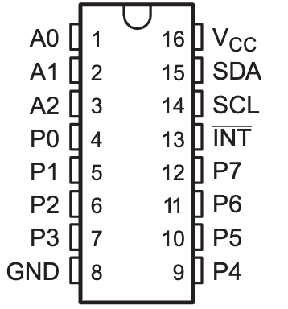
Hardware Peripheral Demo
Original Plan | Current Achievements
Integrate Hardware Peripherals with Main Board | Initialization Steps, printing out received data, Stable data, swapability (re-flash required)
1 Analog and 1 Digital Component | Buttons, Keypad, Rotary Encoder!
Both ports on PCB function with analog and digital components | Both ports on PCB function with analog and digital components (control servo angle)
User creates I2C component configuration | Circumvent Website; instead use scan/initial begin functions upon startup
Next Steps: multiple components on same pcf chip, port design, Slider

Slide 4

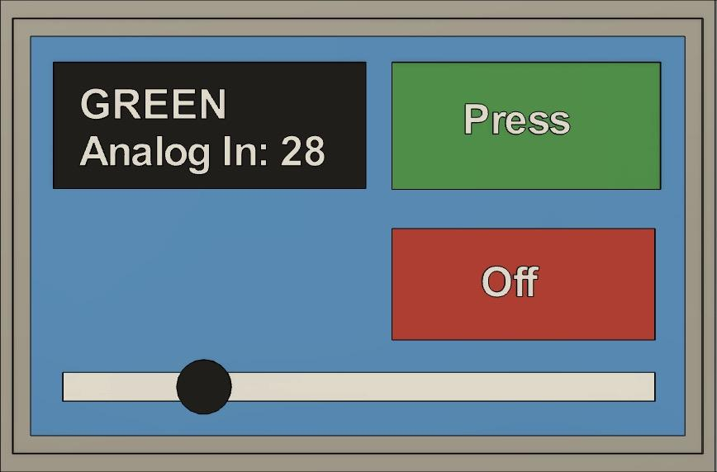
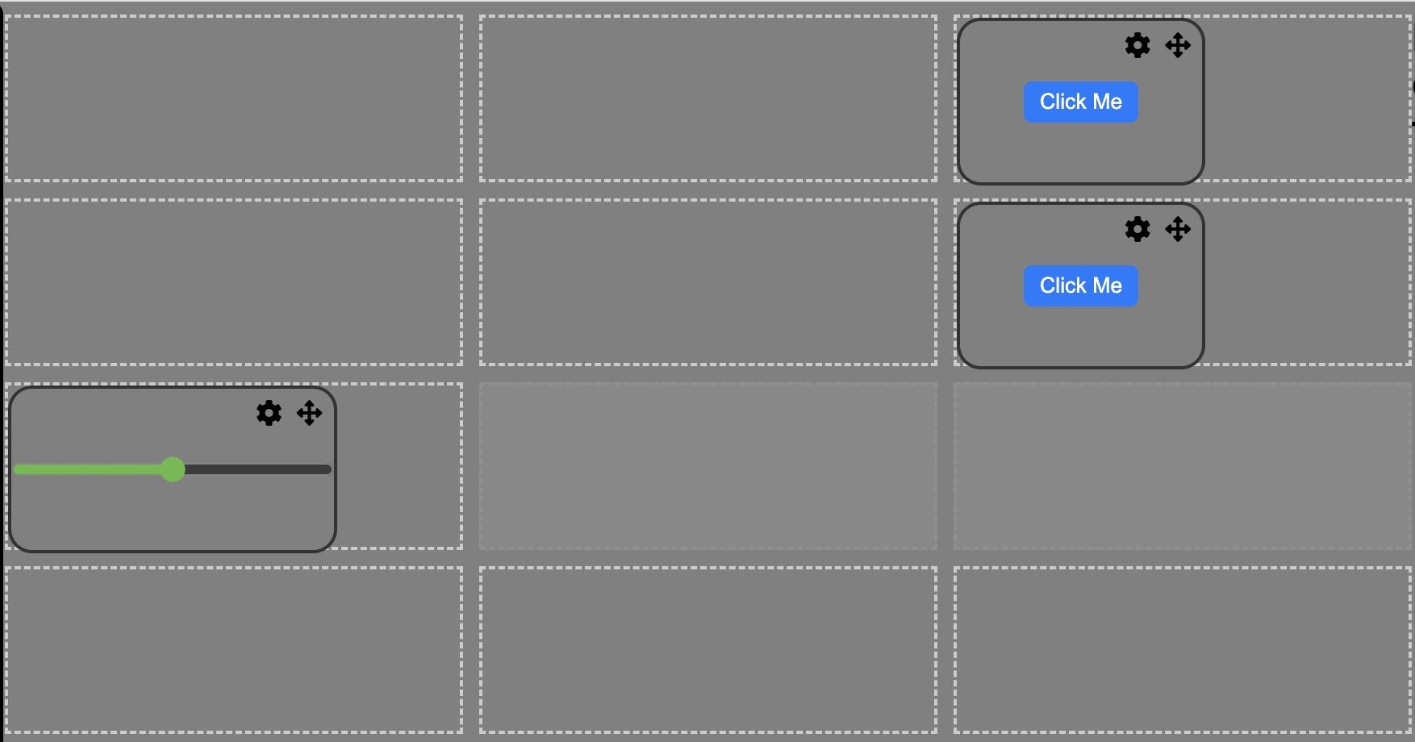
Integration between Protocontrol and User System
Command Protocol
+[component tag]|[value]
x1
x2
x3
Component Tag
- Each component is assigned a unique component identifier assigned by the website that is known to the user
Digital Component
Tag assigned by grid location on website
Hardware Component
Tag assigned by website when chosen
x4
x5
x6
x7
x8
x9
xA
xB
xC
Notes:
Not rlly sure how this slide is relevant, at the very least it should not be the first slide for this subsystem

Slide 5
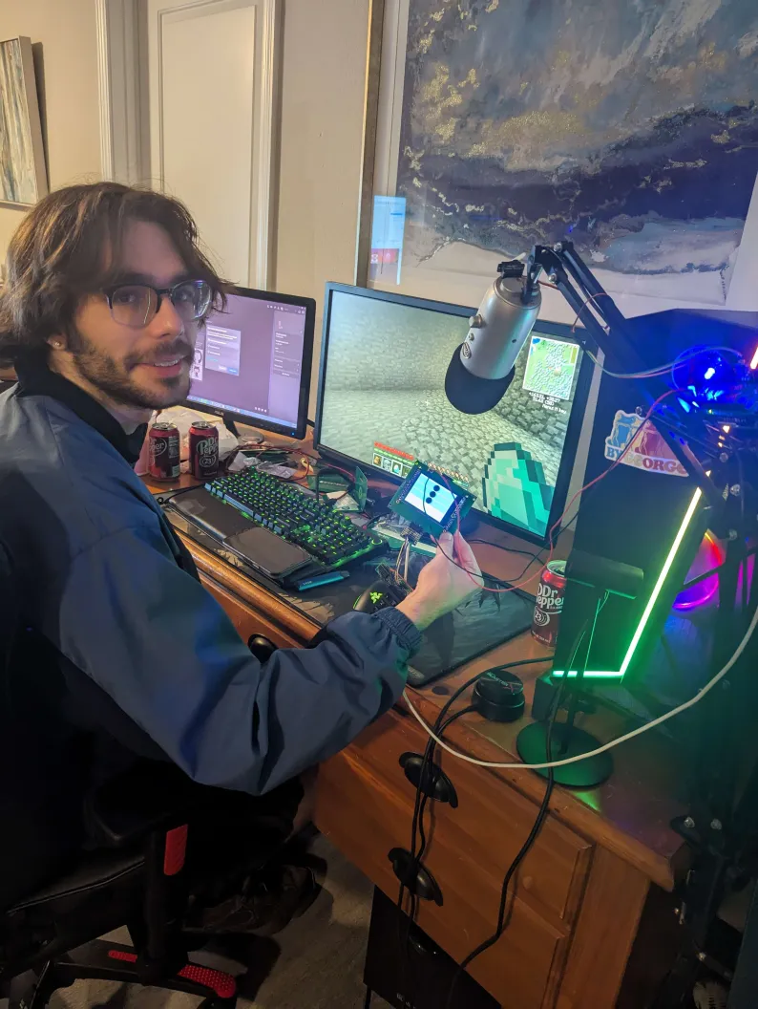
User Demo Results
More labels on the website and the touchscreen
Break down the code in the user manual (almost textbook style
Common Mistakes
Notes:
User feedback
How intuitive does it feel as an end user?
How intuitive is it as a customer?
See the Arduino User System Code

Slide 6
Appendix

Slide 7
Embedded Progress
Digital Components drawn based on SD card
Text file format created
Classes made for Increment, Pushbutton, and toggle
Console with updated values
Serial communication network with user system
Integration with other subsystems

Slide 8
Integration between Protocontrol and User System
Developed command protocol for communication between subsystems
+[command]|[parameters]
ex/ sending text from user system
+write|[line]|[start character]|[user text] \n
ex/ sending component state to user system
+out1|[state of component 1]\n
ex/ changing properties of digital components
+init|[component type]|[component location]|[identifier]\n
Integration
of Subsystems
Website
Protocontrol System
User System
Built Sample User Systems
Arduino
Raspberry Pi

Slide 9
Integration between Protocontrol and User System

Slide 10
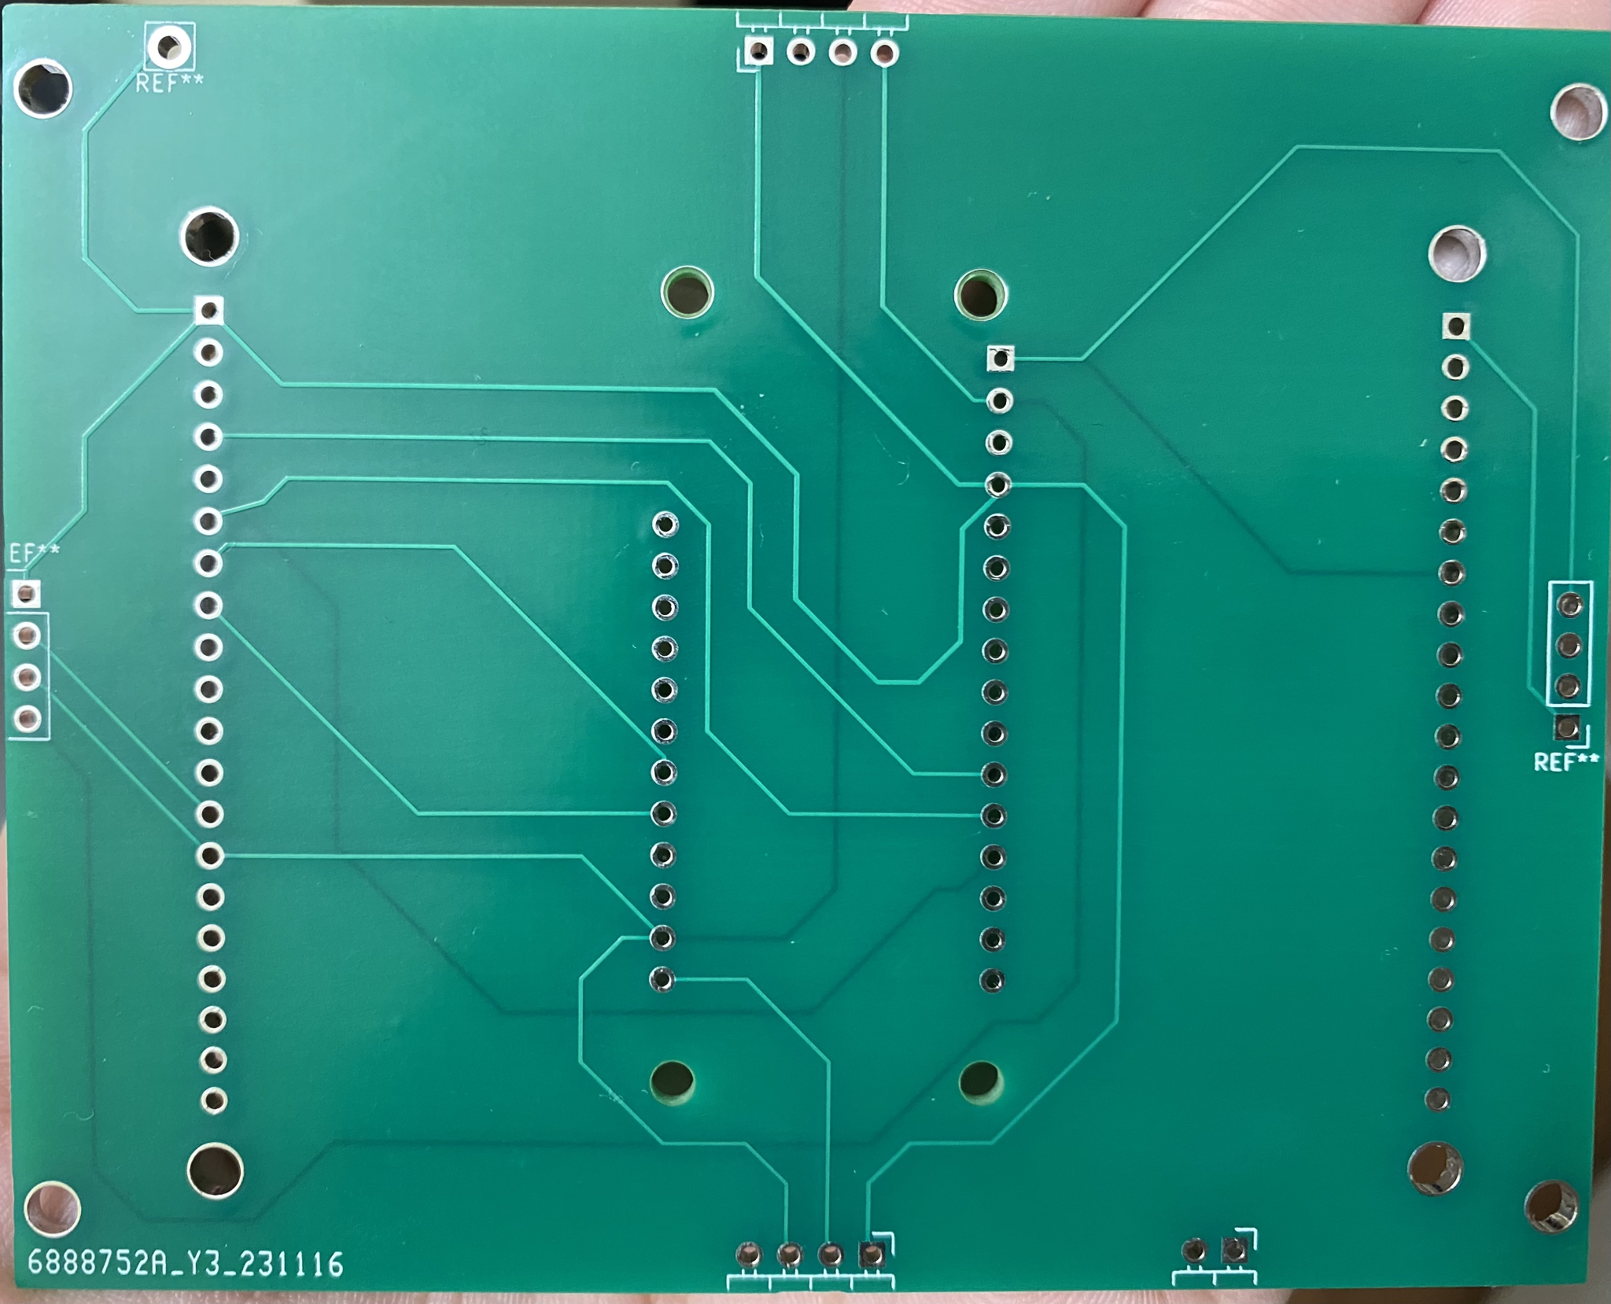
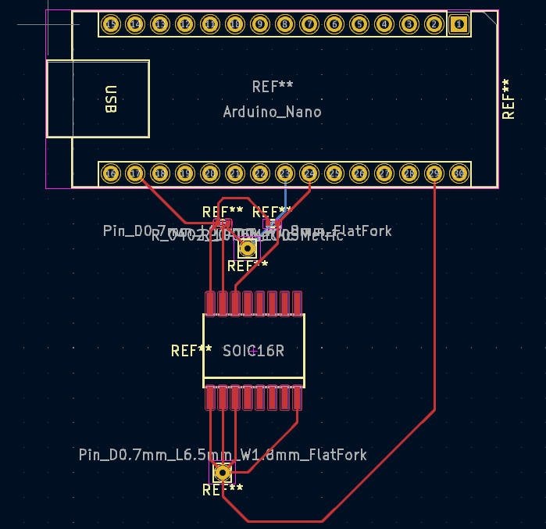
PCB design progress
Progress & Status: Main PCB printed and working
Lessons Learned: Importance of test points, avoiding 90 degree angles, ground travelling parallel to clock traces, flooding a part of the PCB with ground plane
Main PCB
Next Steps: Redesign the I2C pin order to ensure consistent component orientation across sides, design component PCBs to work with PCF8574 (bulk capacitors and more resistors to be added)
Component PCB (PCF8574 & Arduino Nano) - In progress

Slide 11

Hardware Design + Serial Communication progress
Successfully interfaced PCF8574N GPIO Expander with button and led (non-I2C to I2C)
Lessons Learned:
Always check the part id when it arrives in the mail
Next Steps
Interface keypad, slider, and toggles
Make Schematic for PCB (replicate the pin expander)
Use magnetic I2C pogo connectors
Define a more robust way of integrating components (w/o dependence on specific libraries)
Notes:
People Responsible: Abisha, Parker
Next Steps
Interface keypad, slider, and toggles
Buy TIs PC8574 IC and make a Schematic for PCB (replicate the pin expander)
Continue Verilog Modeling of I2C
Explore what modules we have available to us with Vivado

Slide 12

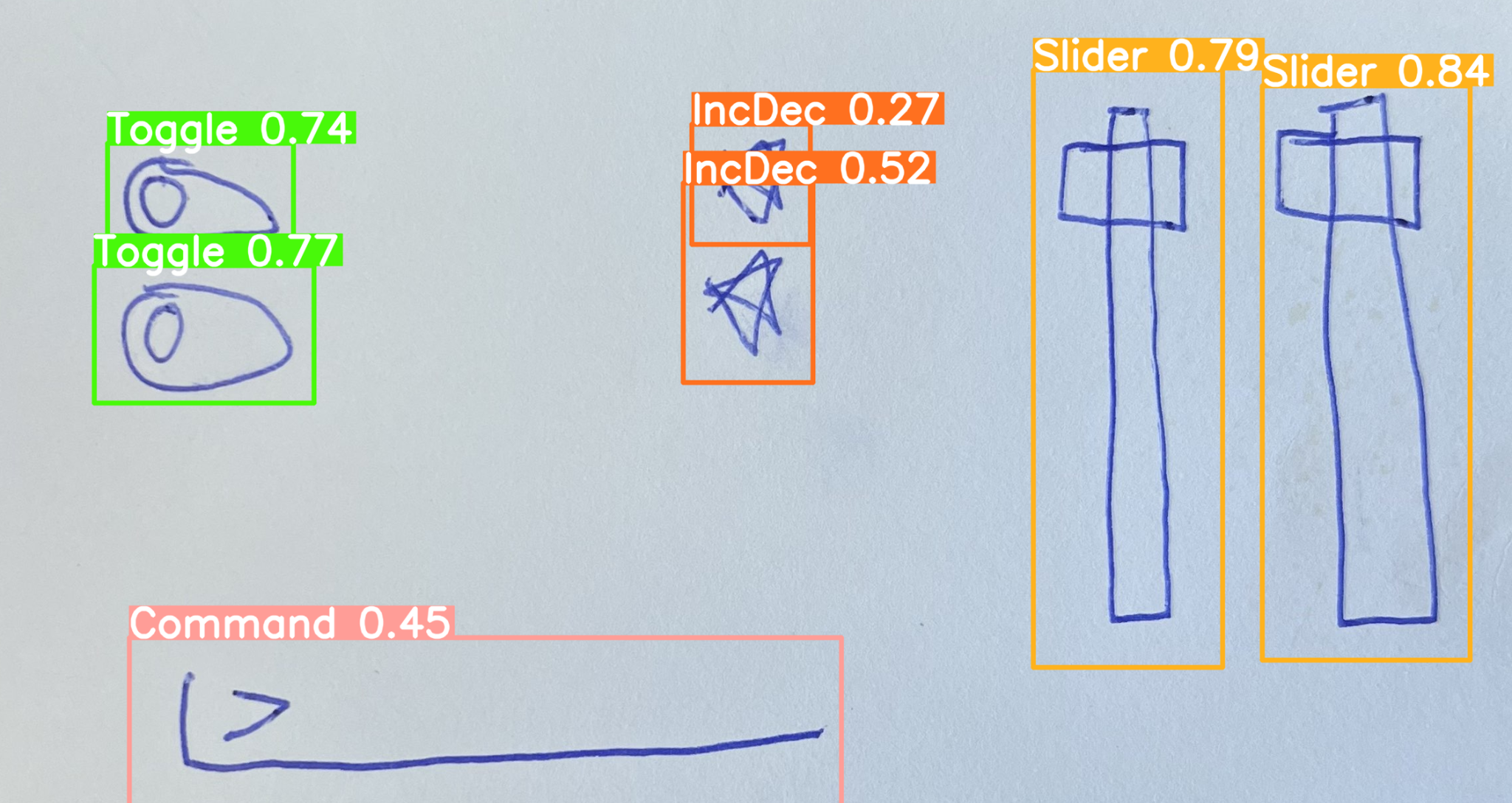
Software Progress
What’s been done:
Optimized image processing & object detection algorithm
New round of training data coming soon
Added and refactored templated embedded code
Looked into web hosting options provided by NCSU
Cross-Platform Application Development
Android/IOS
More info to come (Timeline, Concept Diagrams)

